Slide 1
Absorption

Slide 2
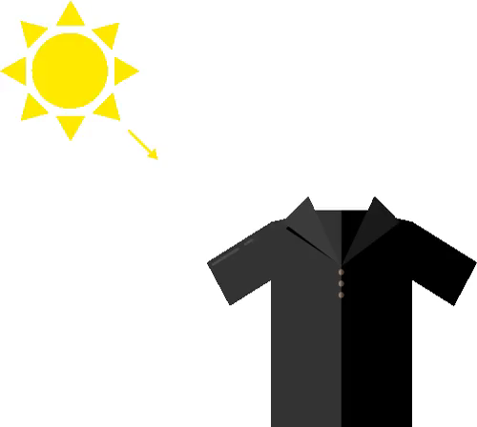
By the end of this lesson you will be able to:
Describe what happens when light hits an object.

Slide 3
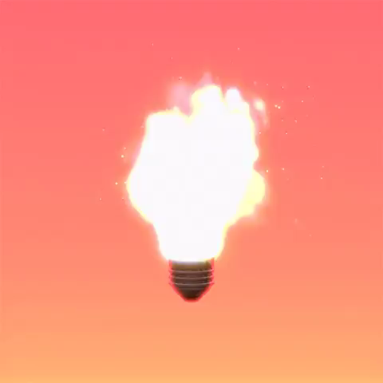
Light is a form of energy.
When a ray of light strikes an object, that energy can be transferred to the surface of the object. We call this process absorption!

Slide 4
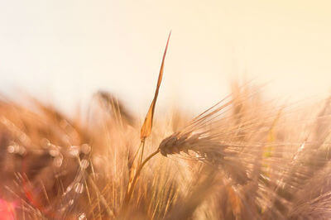
So what actually happens when an object absorbs light?
Well, the energy an object receives from light turns into heat.

Slide 5
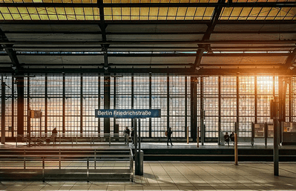
The more light an object absorbs, the warmer it gets in strong, direct sunlight.
Opaque objects absorb more light than transparent and translucent objects.

Slide 6
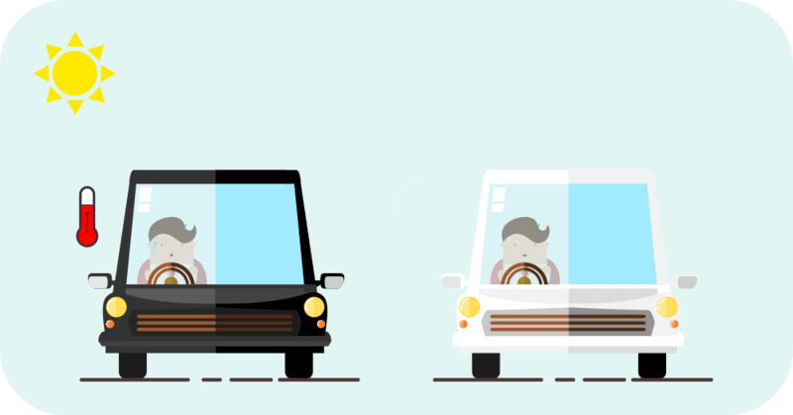
We can see light absorption in action on a sunny day as light hits the different cars on our roads.
Black cars will be warmer because black objects absorb all of the visible parts of light!

Slide 7
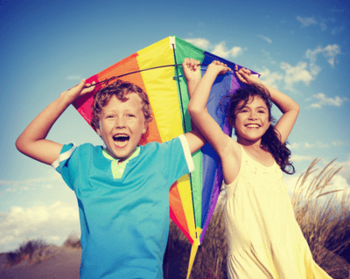
During summer we wear light coloured clothes.
We do this because lighter colours absorb less light. A white shirt will actually reflect all visible parts of light, leaving nothing left to absorb. This way we can remain at a comfortable temperature for longer!

Slide 8
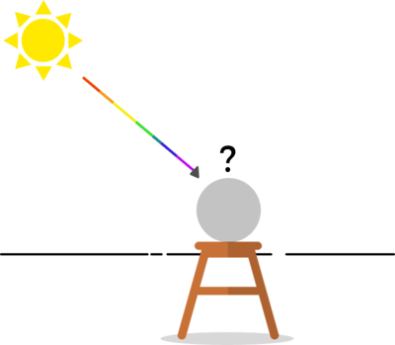
As we have learnt, visible light is made up of different parts we see as colours.
We've also found that the colour of an object is based on what parts of light are reflected and what parts are absorbed.
Let's take a closer look at what is happening during this absorption!

Slide 9
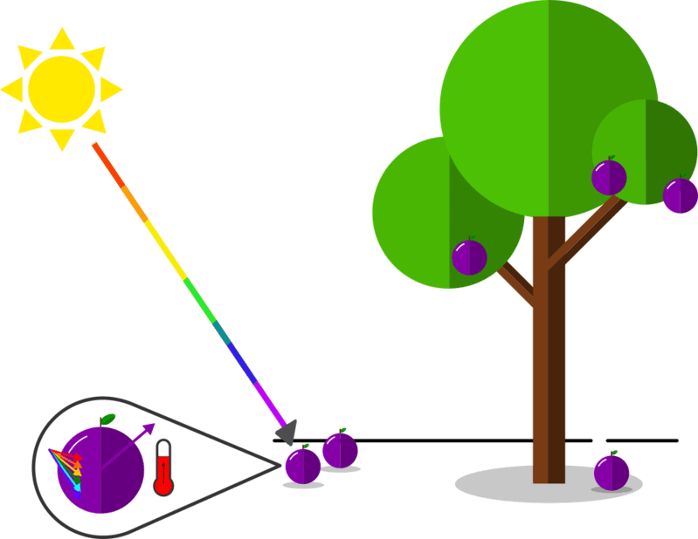
Let's say we are in an orchard and a violet plum is hit by the Sun's rays.
The red, orange, yellow, green, blue and indigo parts of light are taken in by the plum's skin and turned into heat.
We can say that the plum has absorbed all other visible light.

Slide 10
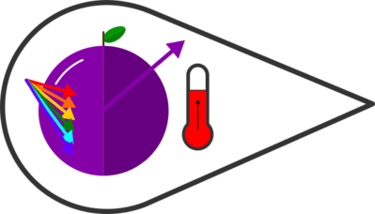
The only colour that isn't absorbed by the plum is violet.
Instead, all of the violet parts bounce off the surface and into our eyes. Because violet light isn't absorbed, we end up seeing a violet plum.
If we were to pick it up, it would be warm with heat energy from absorbing the rest of the light!

Slide 11
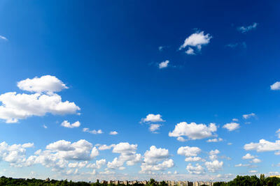
We can also find absorption used for our advantage in photography.
Filters that absorb certain coloured parts are used to create specific styles of pictures.
The parts of light that are allowed through the filter will make the picture look a certain way, like a blue light filter making a sky scene look extra blue.

Slide 12
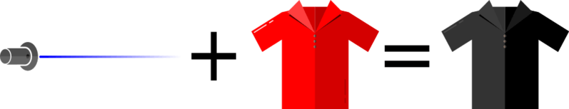
We can also see the process of absorption if we change the colour of our light source.
If we were to shine a specific coloured light like blue onto an object that is red, we see that object turn black! Here we only have blue parts, and they get fully absorbed by the shirt that only reflects red parts of light.

